Slide 1
Hadoop/MapReduce Computing Paradigm

Slide 2


Large-Scale Data Analytics
MapReduce computing paradigm (E.g., Hadoop) vs. Traditional database systems
Database
vs.
Many enterprises are turning to Hadoop
Especially applications generating big data
Web applications, social networks, scientific applications

Slide 3








Why Hadoop is able to compete?
Database
vs.
Scalability (petabytes of data, thousands of machines)
Performance (tons of indexing, tuning, data organization tech.)
Flexibility in accepting all data formats (no schema)
Interactive processing
Efficient and simple fault-tolerant mechanism
Transactions and consistency guarantees (ACID)
Commodity inexpensive hardware
Features:
- Provenance tracking
- Annotation management
- ….

Slide 4








What is MapReduce
MapReduce is a computing paradigm
A specific mechanism of processing the data
MapReduce Relational DBs
Different Implementations/Systems

Slide 5
What is Hadoop
Hadoop is a software framework for distributed processing of large datasets across large clusters of computers
Large datasets → Terabytes or petabytes of data
Large clusters → hundreds or thousands of nodes
Hadoop is open-source implementation for Google MapReduce
Hadoop is based on a simple programming model called MapReduce
Hadoop is based on a simple data model, any data will fit

Slide 6

Compute Cluster
A rack of N machines
One machine ⬅➔ One node

Slide 7
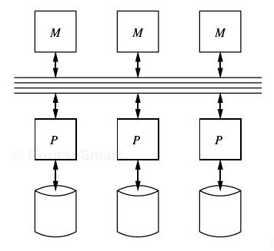
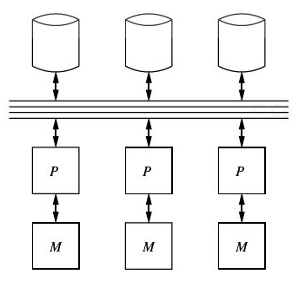
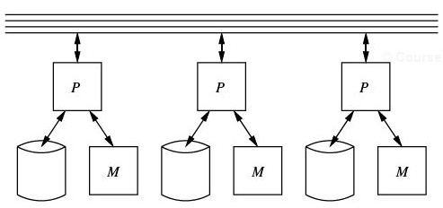
Compute Cluster
Cluster ➔ Set of machines connected together
Shared-memory
Shared-disk
Shared-nothing

Slide 8
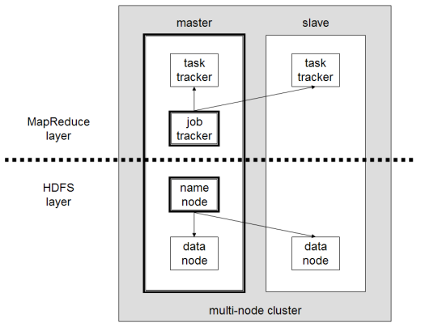
What is Hadoop (Cont’d)
Hadoop framework consists on two main layers
Distributed file system (HDFS)
Execution engine (MapReduce)

Slide 9
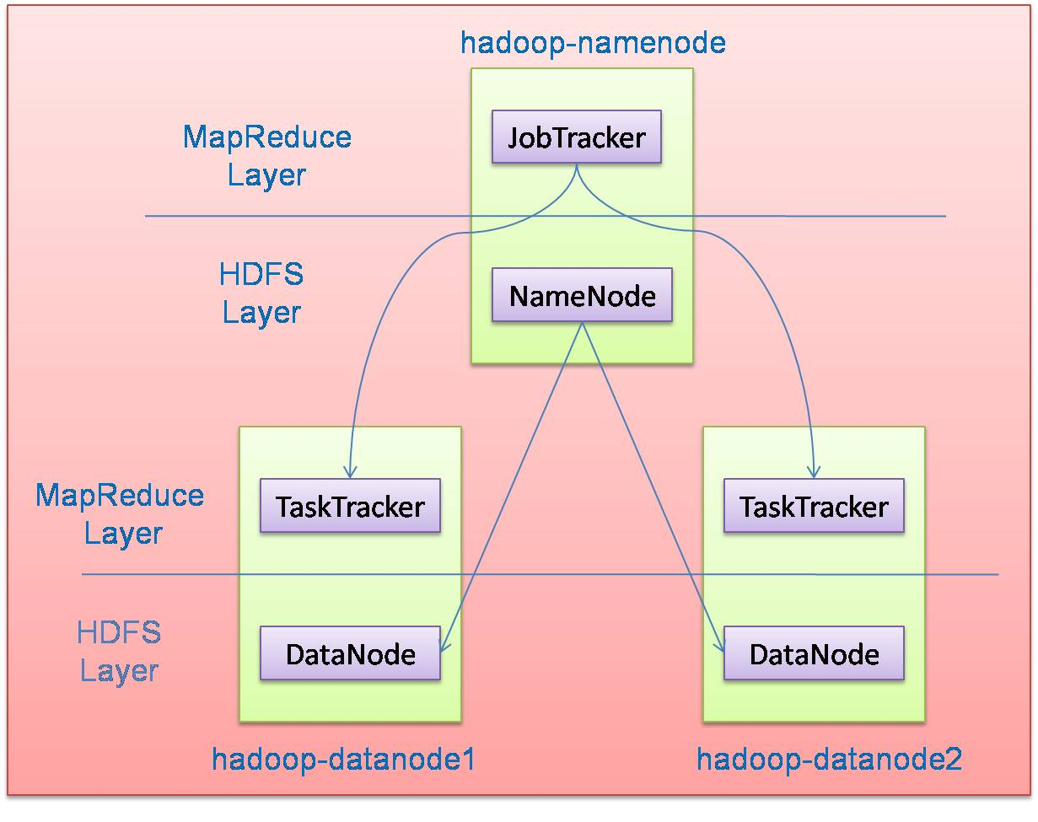
Hadoop Master/Slave Architecture
Hadoop is designed as a master-slave shared-nothing architecture
Master node (single node)
Many slave nodes

Slide 10
Design Principles of Hadoop
Need to process big data
Need to parallelize computation across thousands of nodes
Commodity hardware
Large number of low-end cheap machines working in parallel to solve a computing problem
This is in contrast to Parallel DBs
Small number of high-end expensive machines

Slide 11
Design Principles of Hadoop
Automatic parallelization & distribution
Hidden from the end-user
Fault tolerance and automatic recovery
Nodes/tasks will fail and will recover automatically
Clean and simple programming abstraction
Users only provide two functions “map” and “reduce”

Slide 12
Who Uses MapReduce/Hadoop
Google: Inventors of MapReduce computing paradigm
Yahoo: Developing Hadoop open-source of MapReduce
IBM, Microsoft, Oracle
Facebook, Amazon, AOL, NetFlix
Many others + universities and research labs

Slide 13
Hadoop: How it Works

Slide 14
Hadoop Architecture
Distributed file system (HDFS)
Execution engine (MapReduce)
Master node (single node)
Many slave nodes

Slide 15
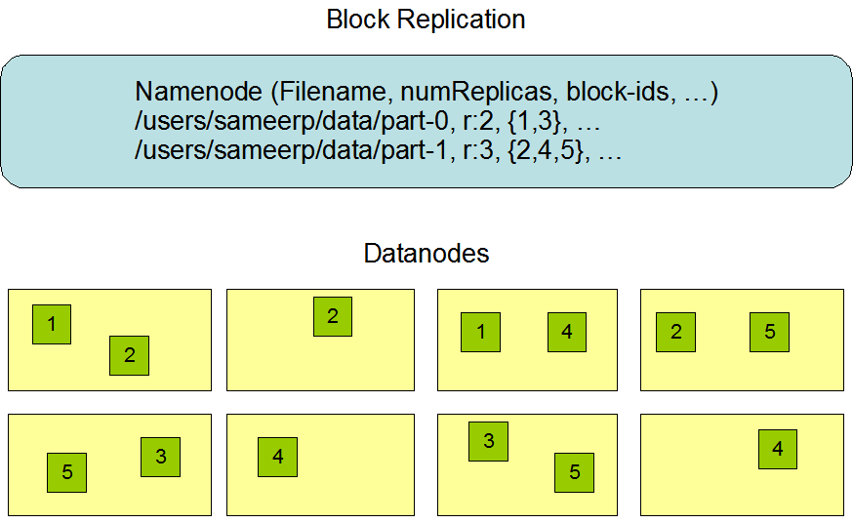
Hadoop Distributed File System (HDFS)
Centralized namenode
- Maintains metadata info about files
File F
1
2
3
4
5
Blocks (64 MB)
Many datanode (1000s)
- Store the actual data
- Files are divided into blocks
- Each block is replicated N times
(Default = 3)

Slide 16
Main Properties of HDFS
Large: A HDFS instance may consist of thousands of server machines, each storing part of the file system’s data
Replication: Each data block is replicated many times (default is 3)
Failure: Failure is the norm rather than exception
Fault Tolerance: Detection of faults and quick, automatic recovery from them is a core architectural goal of HDFS
Namenode is consistently checking Datanodes

Slide 17
Map-Reduce Execution Engine (Example: Color Count)
Input blocks on HDFS
Produces (k, v)
( , 1)
Shuffle & Sorting based on k
Consumes(k, [v])
( , [1,1,1,1,1,1..])
Produces(k’, v’)
( , 100)
Users only provide the “Map” and “Reduce” functions

Slide 18
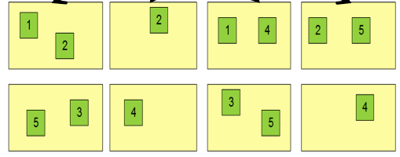
Properties of MapReduce Engine
Job Tracker is the master node (runs with the namenode)
Receives the user’s job
Decides on how many tasks will run (number of mappers)
Decides on where to run each mapper (concept of locality)
Node 1
Node 2
Node 3
This file has 5 Blocks → run 5 map tasks
Where to run the task reading block “1”
Try to run it on Node 1 or Node 3

Slide 19
Properties of MapReduce Engine (Cont’d)
Task Tracker is the slave node (runs on each datanode)
Receives the task from Job Tracker
Runs the task until completion (either map or reduce task)
Always in communication with the Job Tracker reporting progress
In this example, 1 map-reduce job consists of 4 map tasks and 3 reduce tasks

Slide 20
Key-Value Pairs
Mappers and Reducers are users’ code (provided functions)
Just need to obey the Key-Value pairs interface
Mappers:
Consume <key, value> pairs
Produce <key, value> pairs
Reducers:
Consume <key, <list of values>>
Produce <key, value>
Shuffling and Sorting:
Hidden phase between mappers and reducers
Groups all similar keys from all mappers, sorts and passes them to a certain reducer in the form of <key, <list of values>>

Slide 21
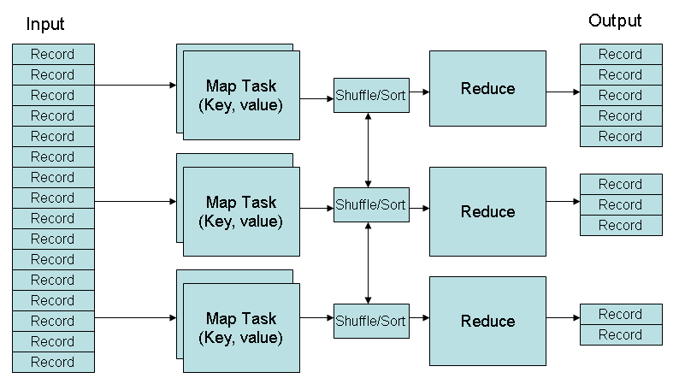
MapReduce Phases
Deciding on what will be the key and what will be the value ➔ developer’s responsibility

Slide 22
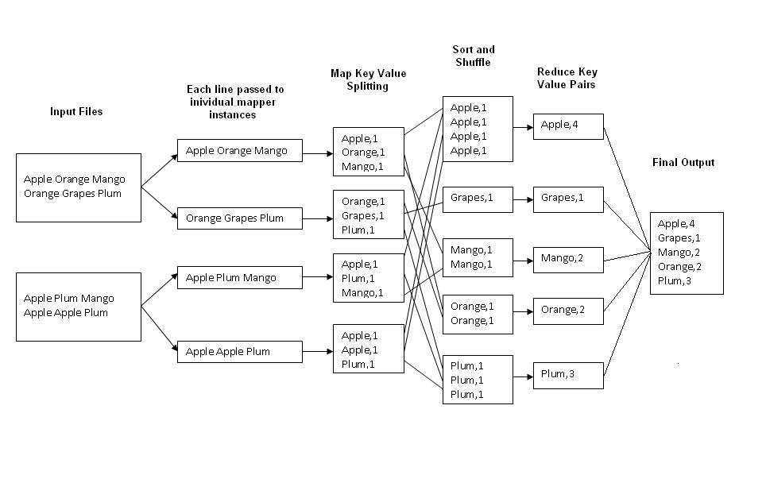
Example 1: Word Count
Job: Count the occurrences of each word in a data set
Map
Tasks
Reduce
Tasks

Slide 23
Example 2: Color Count
Job: Count the number of each color in a data set
Input blocks on HDFS
Produces (k, v)
( , 1)
Shuffle & Sorting based on k
Consumes(k, [v])
( , [1,1,1,1,1,1..])
Produces(k’, v’)
( , 100)
Part0001
Part0002
Part0003
That’s the output file, it has 3 parts on probably 3 different machines

Slide 24
Example 3: Color Filter
Job: Select only the blue and the green colors
Each map task will select only the blue or green colors
No need for reduce phase
Input blocks on HDFS
Produces (k, v)
( , 1)
Write to HDFS
Part0001
Write to HDFS
Part0002
That’s the output file, it has 4 parts on probably 4 different machines
Write to HDFS
Part0003
Write to HDFS
Part0004

Slide 25
MapReduce Phases
Deciding on what will be the key and what will be the value ➔ developer’s responsibility

Slide 26
Processing Granularity
Mappers
Run on a record-by-record bases
Your code processes that record and may produce
Zero, one, or many outputs
Reducers
Run on a group-of-records bases (having same key)
Your code processes that group and may produce
Zero, one, or many outputs

Slide 27
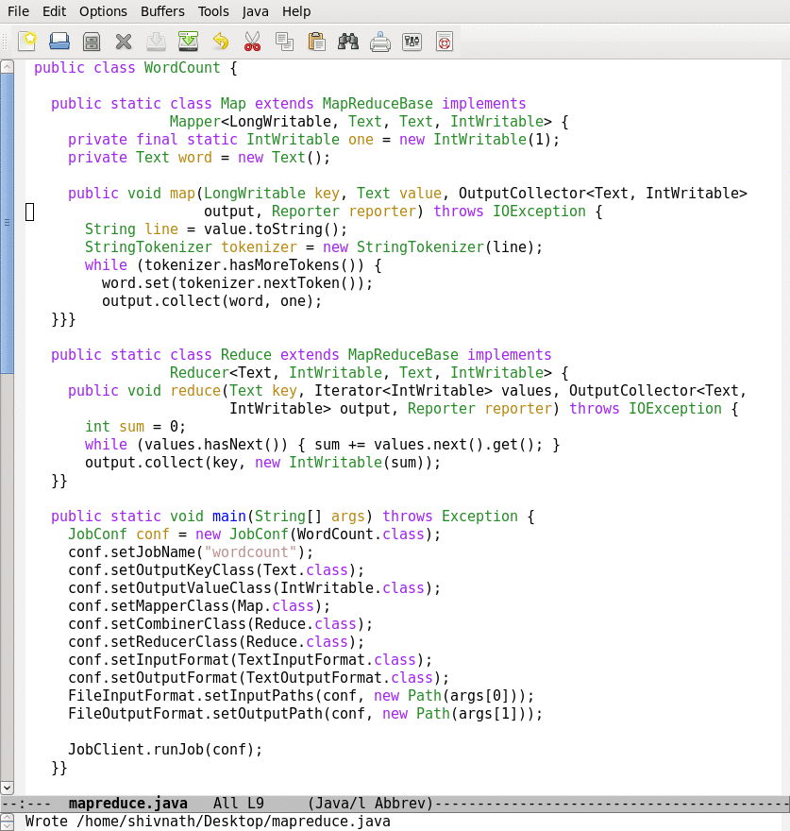
How it looks like in Java
Provide implementation for Hadoop’s Mapper abstract class
Map function
Provide implementation for Hadoop’s Reducer abstract class
Reduce function
Job configuration

Slide 28
Optimization 1
In Color Count example, assume I know that the number of colors is small → can we optimize the map-side
 | 10
 | 5
 | 7
 | 20
Each map function can have a small main-memory hash table (color, count)
With each line, update the hash table and produce nothing
When done, report each color and its local count
Gain: Reduce the amount of shuffled/sorted data over the network
Q1: Where to build the hash table?
Q2: How to know when done?

Slide 29
Optimization 1: Takes Place inside Mappers
Saves network messages (Typically very expensive phase)
Input blocks on HDFS
Produces (k, v)
( , 100)
Shuffle & Sorting based on k
Consumes(k, [v])
( , [1,1,1,1,1,1..])
Produces(k’, v’)
( , 100)
Part0001
Part0002
Part0003
That’s the output file, it has 3 parts on probably 3 different machines

Slide 30
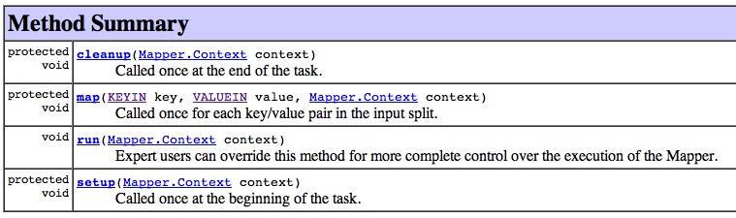
Inside the Mapper Class
Called once after all records (Here you can produce the output)
Called for each record
Called once before any record (Here you can build the hash table)
Reducer has similar functions…

Slide 31
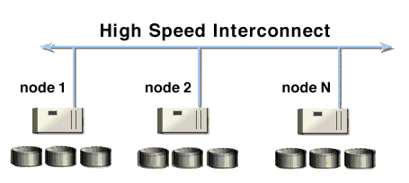
Optimization 2: Map-Combine-Reduce
What about partially aggregating the results from mappers on each machine
Mappers 1…3
Mappers 4…6
Mappers 7…9
A combiner is a reducer that runs on each machine to partially aggregate (that’s a user code) mappers’ outputs from this machine
Then, combiners output is shuffled/sorted for reducers

Slide 32
Optimization 2: Outside Mappers, But on Each Machine
Combiner runs on each node to partially aggregate the local mappers’ output
Input blocks on HDFS
Produces (k, v)
( , 1)
Shuffle & Sorting based on k
Consumes(k, [v])
( , [1,1,1,1,1,1..])
Produces(k’, v’)
( , 100)
Part0001
Part0002
Part0003
That’s the output file, it has 3 parts on probably 3 different machines

Slide 33
Tell Hadoop to use a Combiner
Not all jobs can use a combiner
Use a combiner

Slide 34
Optimizations 3: Speculative Execution
If one node is slow, it will slow the entire job
Speculative Execution: Hadoop automatically runs each task multiple times in parallel on different nodes
First one finishes, the others will be killed

Slide 35
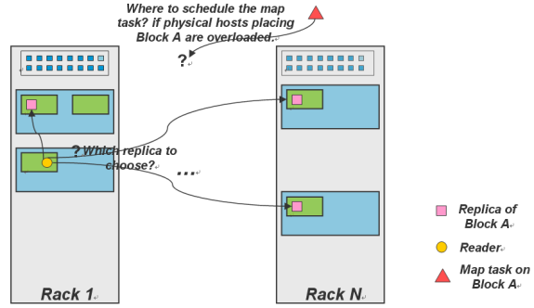
Optimizations 4: Locality
Locality: try to run the map code on the same machine that has the relevant data
If not possible, then machine in the same rack
Best effort, no guarantees

Slide 36
Translating DB Operations to Hadoop Jobs

Slide 37
DB Operations
Select (Filter)
Projection
Grouping and aggregation
Duplicate Elimination
Join

Slide 38
Selection: σ
Select: σ_{c} (R):
c is a condition on R’s attributes
Select subset of tuples from R that satisfy selection condition c
Select *
From R
Where R.A = R.B
And R.D > 5;
In Hadoop, Selection is implemented as a Map-Only Job

Slide 39
Back to Color Filter
Job: Select only the blue and the green colors
Each map task will select only the blue or green colors
No need for reduce phase
Input blocks on HDFS
Produces (k, v)
( , 1)
Write to HDFS
Part0001
Write to HDFS
Part0002
That’s the output file, it has 4 parts on probably 4 different machines
Write to HDFS
Part0003
Write to HDFS
Part0004

Slide 40
Projection: π
π_{A1, A2, …, An} (R), with A1, A2, …, An ∈ attributes A_{R}
returns all tuples in R, but only columns A1, A2, …, An
A1, A2, …, An are called Projection List
Select C, A as V, C*3+B as X
From R;
In Hadoop, Projection is implemented as a Map-Only Job

Slide 41
Grouping & Aggregation
Aggregation function takes a collection of values and returns a single value as a result
avg: average value
min: minimum value
max: maximum value
sum: sum of values
count: number of values
Grouing & Aggregate operation in relational algebra
γg1,g2, …gm, F1(A1), F2(A2), …Fn(An) (R)
R is a relation or any relational-algebra expression
g1, g2, …gm is a list of attributes on which to group (can be empty)
Each Fi is an aggregate function applied on attribute Ai within each group

Slide 42

Grouping & Aggregation Operator: Example
In Hadoop, Grouping & Aggregation is implemented as a
Map-Reduce Job
Select sum(C)
From R;
Select sum(balance)
From S
Group By branch_name;
What is the key/value?

Slide 43
Back to Word Count
Job: Count the occurrences of each word in a data set
Map
Tasks
Reduce
Tasks

Slide 44
Duplicate Elimination: δ (R)
Delete all duplicate records
Convert a bag to a set
In Hadoop, duplicate elimination is implemented as a
Map-Reduce Job
Select Distinct *
From R;
What is the key/value?

Slide 45
Join: R ⋈_{C} S
Theta Join is cross product, with condition C
It is defined as : R ⋈_{C} S = (σ_{C} (R X S))

Slide 46
Joining Two Large Datasets: Re-Partition Join
Dataset A
Dataset B
Different join keys
Reducers perform the actual join
Reducer 1
Reducer 2
Reducer N
Shuffling and sorting over the network
Shuffling and Sorting Phase
- Each mapper processes one block (split)
- Each mapper produces the join key and the record pairs
Mapper 1
Mapper 2
Mapper 3
Mapper M+N
HDFS stores data blocks
(Replicas are not shown)

Slide 47
Joining Large Dataset (A) with Small Dataset (B) Broadcast/Replication Join
Dataset A
Dataset B
Different join keys
Every map task processes one block from A and the entire B
Every map task performs the join (MapOnly job)
Avoid the shuffling and reduce expensive phases
Mapper 1
Mapper 2
Mapper N
HDFS stores data blocks
(Replicas are not shown)

Slide 48
Translating DB Operations to Hadoop Jobs (Summary)
Select (Filter) → Map-only job
Projection → Map-only job
Grouping and aggregation → Map-Reduce job
Duplicate Elimination → Map-Reduce job
Map (Key= hash code of the tuple, Value= tuple itself)
Join → Map-Reduce job

Slide 49
Hadoop Black-Box Model
DBMSs have an Open-Box Model
Data are known (DB Schema)
Queries are known (written in SQL)
Hadoop has a Black-Box Model
Data are not known (files of unknown structure)
Jobs are also unknown (written in java)
Hadoop does very limited optimizations

Slide 50
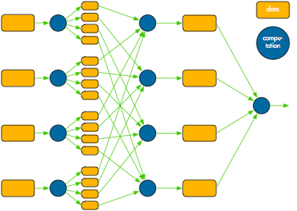
Hadoop Fault Tolerance
Intermediate data between mappers and reducers are materialized to simple & straightforward fault tolerance
What if a task fails (map or reduce)?
Tasktracker detects the failure
Sends message to the jobtracker
Jobtracker re-schedules the task
What if a datanode fails?
Both namenode and jobtracker detect the failure
All tasks on the failed node are re-scheduled
Namenode replicates the users’ data to another node
What if a namenode or jobtracker fails?
The entire cluster is down
Intermediate data
(materialized)

Slide 51
Simplicity Comes From…
Jobs are read-only (do not change or modify data)
Intermediate data between mappers & reducers is materialized until job finishes

Slide 52
More About Execution Phases

Slide 53
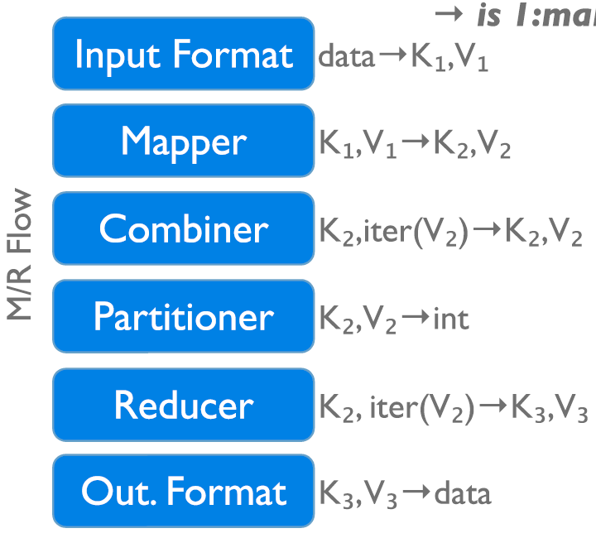
Execution Phases
InputFormat
Map function
Partitioner
Sorting & Merging
Combiner
Shuffling
Merging
Reduce function
OutputFormat

Slide 54
Reminder about Covered Phases
Job: Count the number of each color in a data set
Input blocks on HDFS
Produces (k, v)
( , 1)
Shuffle & Sorting based on k
Consumes(k, [v])
( , [1,1,1,1,1,1..])
Produces(k’, v’)
( , 100)
Part0001
Part0002
Part0003
That’s the output file, it has 3 parts on probably 3 different machines

Slide 55
Partitioners
The output of the mappers need to be partitioned
# of partitions = # of reducers
The same key in all mappers must go to the same partition (and hence same reducer)
Default partitioning is hash-based
Users can customize it as they need

Slide 56
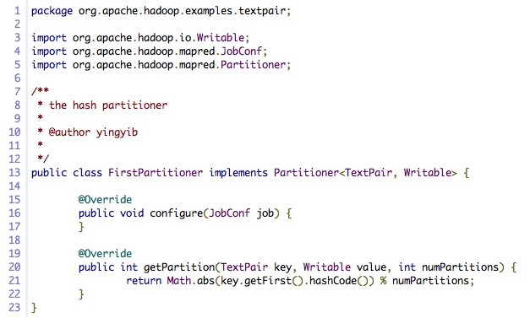
Customized Partitioner
Returns a partition Id

Slide 57
Optimization: Balance the Load among Reducers
Assume we have N reducers
Many keys {k1, k2, …, Km}
Distribution is skew
K1 and K2 have many records
Send K1 to Reducer 1
Send K2 to Reducer 2
K3, K5
K7, K10, K20
Rest are hash-based
…..
…..

Slide 58
Input/Output Formats
Hadoop’s data model ⬅ Any data in any format will fit
Text, binary, in a certain structure
How Hadoop understands and reads the data ??
The input format is the piece of code that understands the data and how to reads it
Hadoop has several built-in input formats to use
Text files, binary sequence files

Slide 59
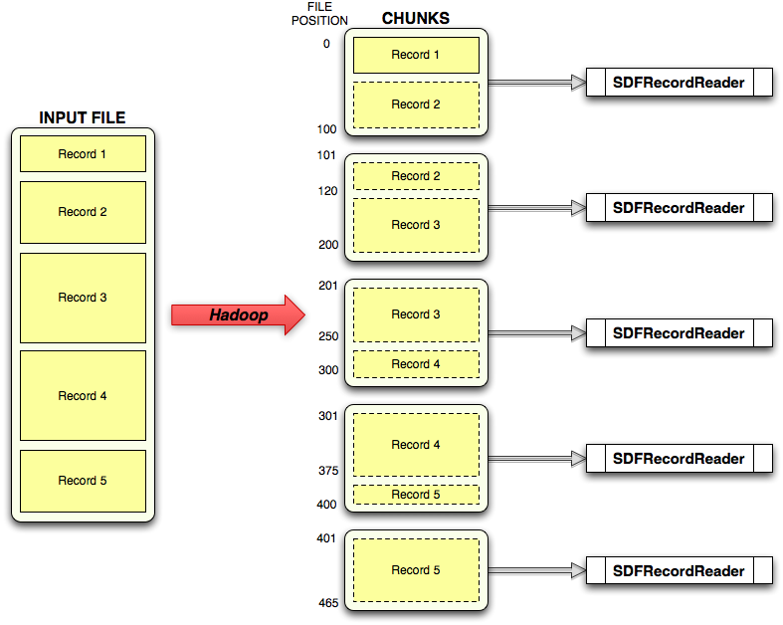
Input Formats
Record reader reads bytes and converts them to records

Slide 60
Tell Hadoop which Input/Output Formats
Define the formats

Slide 61
We Covered All Execution Phases
InputFormat
Map function
Partitioner
Sorting & Merging
Combiner
Shuffling
Merging
Reduce function
OutputFormat

Slide 62

Any Questions So Far…

Slide 63
More on HDFS

Slide 64
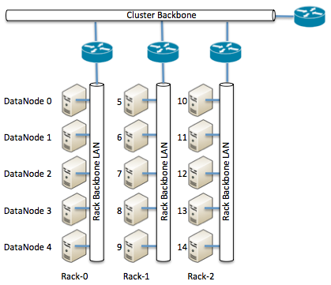
HDFS and Placement Policy
Default Placement Policy
First copy is written to the node creating the file (write affinity)
Second copy is written to a data node within the same rack
Third copy is written to a data node in a different rack
Objective: load balancing & fault tolerance
Rack-aware replica placement

Slide 65
Safemode Startup
On startup Namenode enters Safemode (few seconds).
Each DataNode checks in with Heartbeat and BlockReport.
Namenode verifies that each block has acceptable number of replicas
If things are fine ➔ Namenode exits Safemode
If some blocks are under replicated
Replicate these blocks to other Datanodes
Then, exit safemode

Slide 66
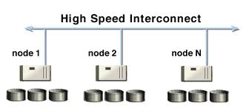
The Communication Protocol
All HDFS communication protocols are layered on top of the TCP/IP protocol
A client establishes a connection to a configurable TCP port on the Namenode machine. It talks ClientProtocol with the Namenode
The Datanodes talk to the Namenode using Datanode protocol
File transfers are done directly between datanodes
Does not go though the namenode

Slide 67
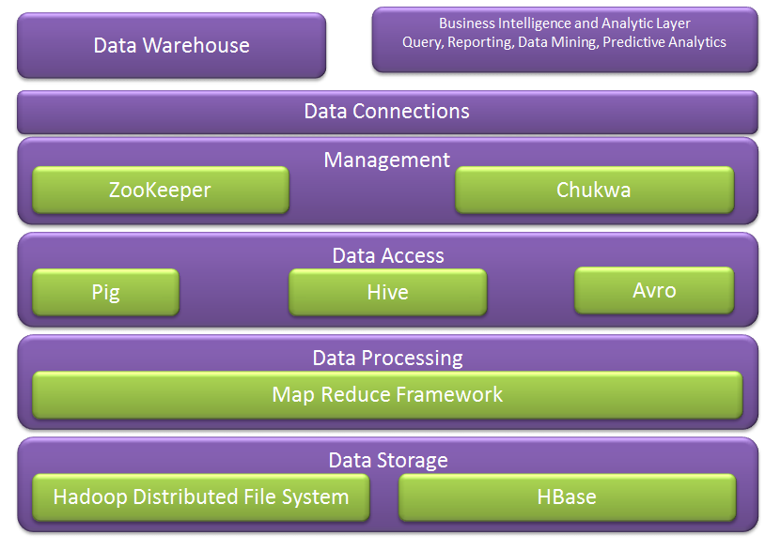
Hadoop Ecosystem
Next week we cover more of these
We covered these

Slide 68
Configuration
Several files control Hadoop’s cluster configurations
Mapred-site.xml: map-reduce parameters
Hdfs-site.xml: HDFS parameters
Matsers: Which node(s) are the master ones
Slaves: which nodes are the slaves
Hadoop has around 190 parameters
Mostly 10-20 are the effective ones

Slide 69
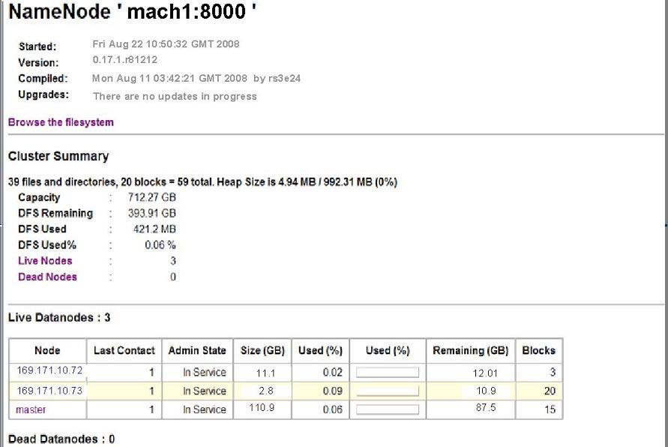
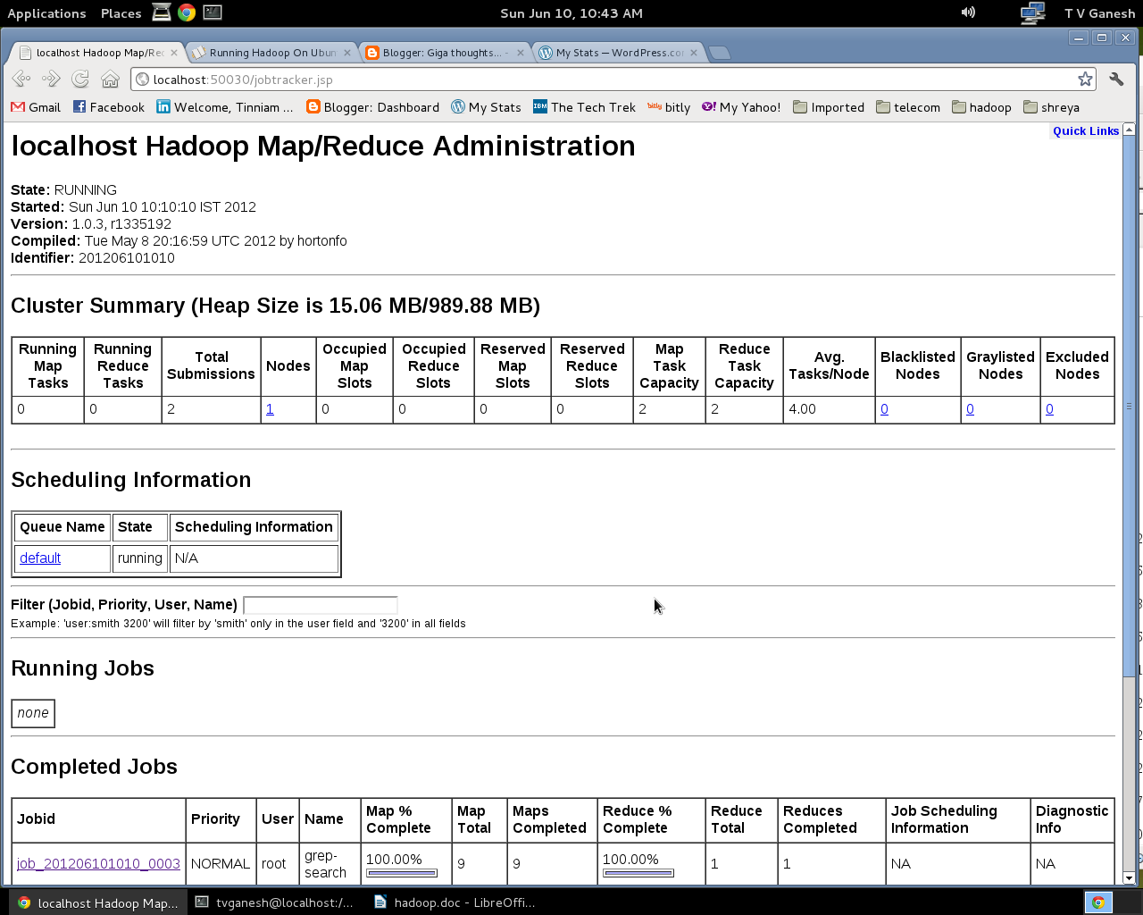
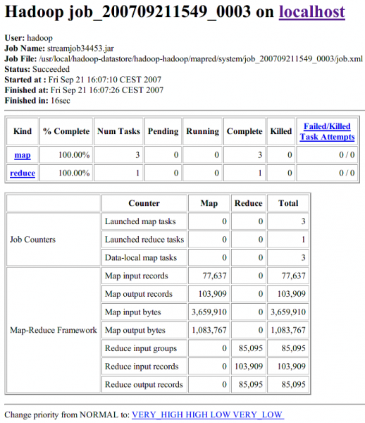
Web Interface
HDFS Interface
MapReduce Interface

Slide 70
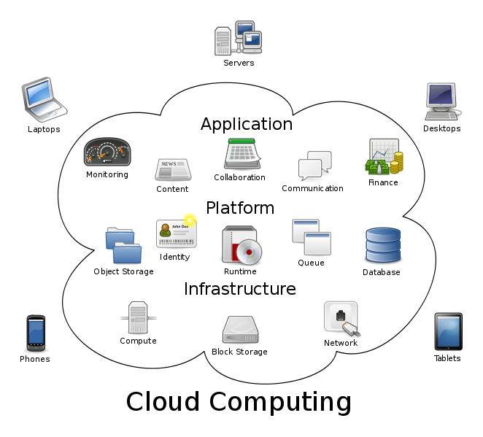
Bigger Picture: Hadoop vs. Other Systems
 | Distributed Databases | Hadoop
Computing Model | Notion of transactions Transaction is the unit of work ACID properties, Concurrency control | Notion of jobs Job is the unit of work No concurrency control
Data Model | Structured data with known schema Read/Write mode | Any data will fit in any format (un)(semi)structured ReadOnly mode
Cost Model | Expensive servers | Cheap commodity machines
Fault Tolerance | Failures are rare Recovery mechanisms | Failures are common over thousands of machines Simple yet efficient fault tolerance
Key Characteristics | - Efficiency, optimizations, fine-tuning | - Scalability, flexibility, fault tolerance
Cloud Computing
A computing model where any computing infrastructure can run on the cloud
Hardware & Software are provided as remote services
Elastic: grows and shrinks based on the user’s demand
Example: Amazon EC2

Slide 71
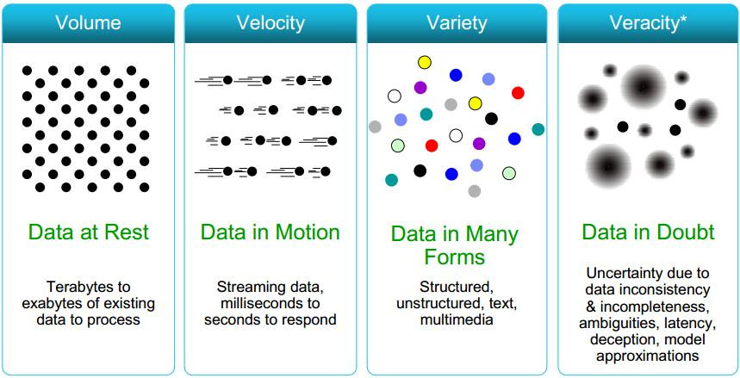
Recall…DBMS
Data is nicely structured (known in advance)
Data is correct & certain
Data is relatively static & small-mid size
Access pattern: Mix Read/Write
Notion of transactions
In Big Data: It is read only, No notion of transactions

Slide 72
What About Hadoop
Any structure will fit
Data is correct & certain
Data is static, but scales to petabytes
Access pattern: Read-Only
Notion of jobs
In Big Data: It is read only, No notion of transactions

